Slide 1
U.S. Airline Performance & Delay Analysis
A Data-Driven Dashboard using PostgreSQL + Tableau

Slide 2
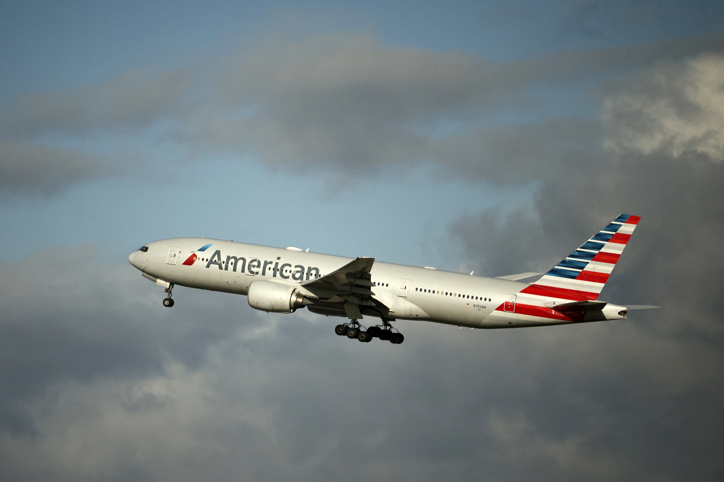
Objectives
Analyze flight performance data
Clean and transform raw datasets
Join related tables
Visualize key performance metrics
Identify high-delay routes and major cancellation reasons
Track trends over time

Slide 3
Visual aids (Dashboards)

Slide 4
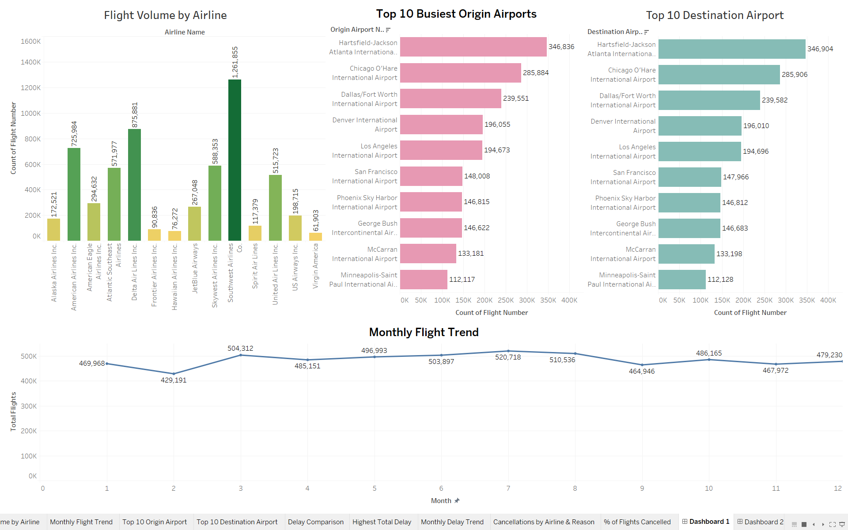
Dashboard 1

Slide 5
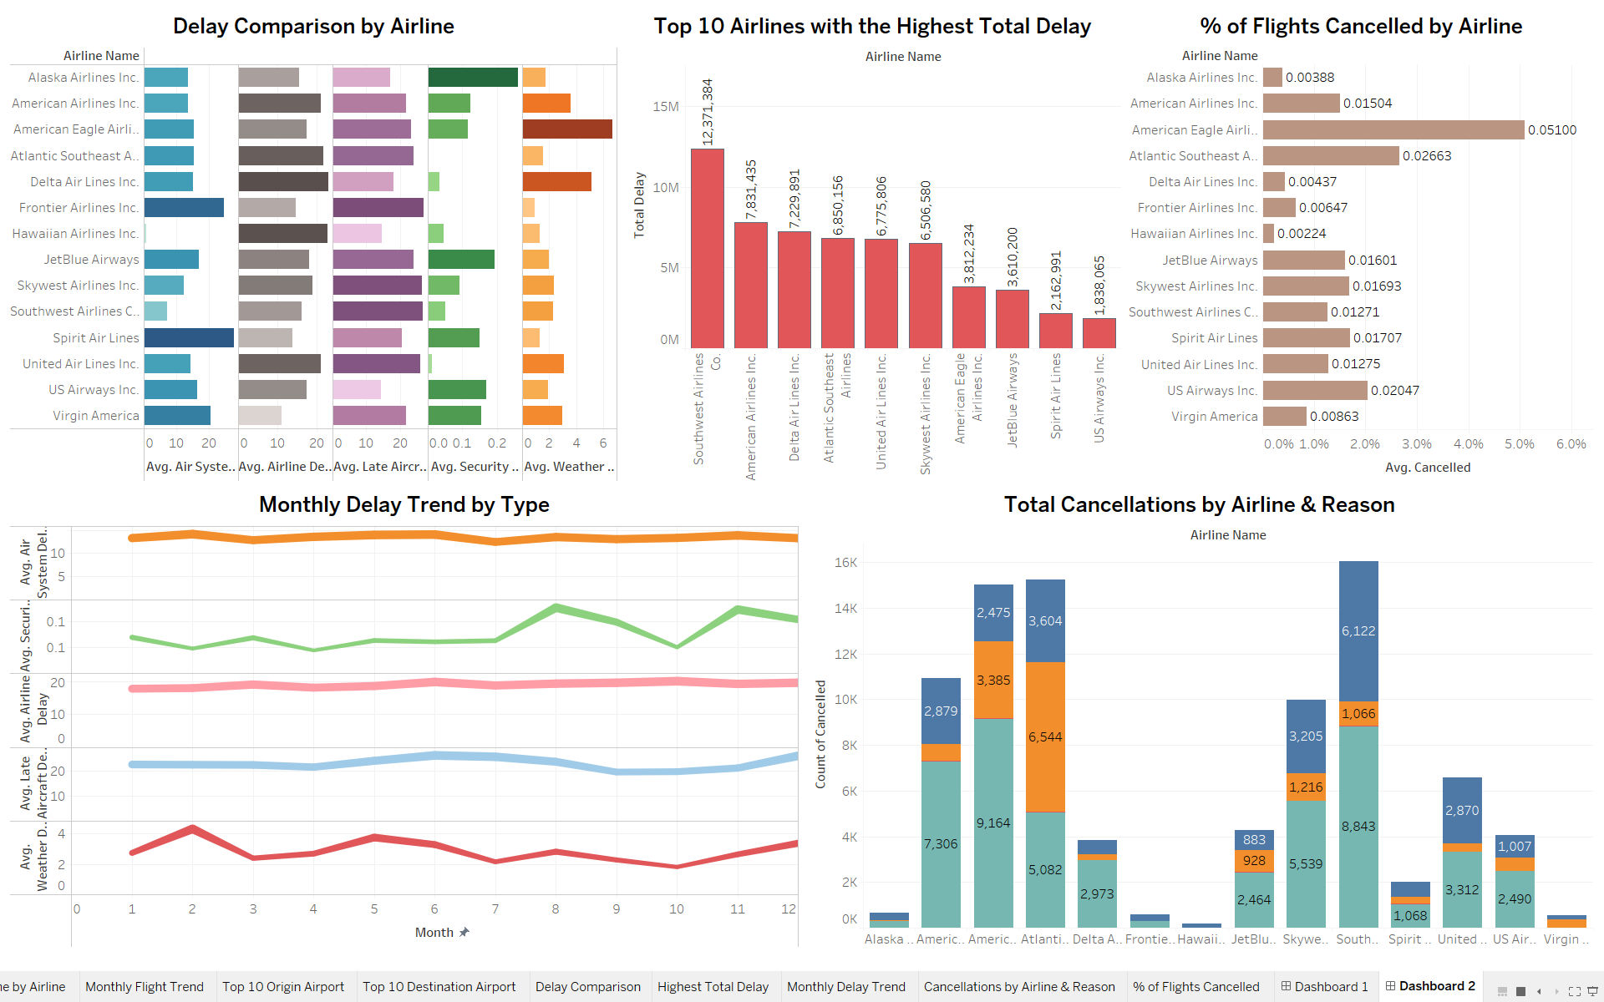
Dashboard 2

Slide 6
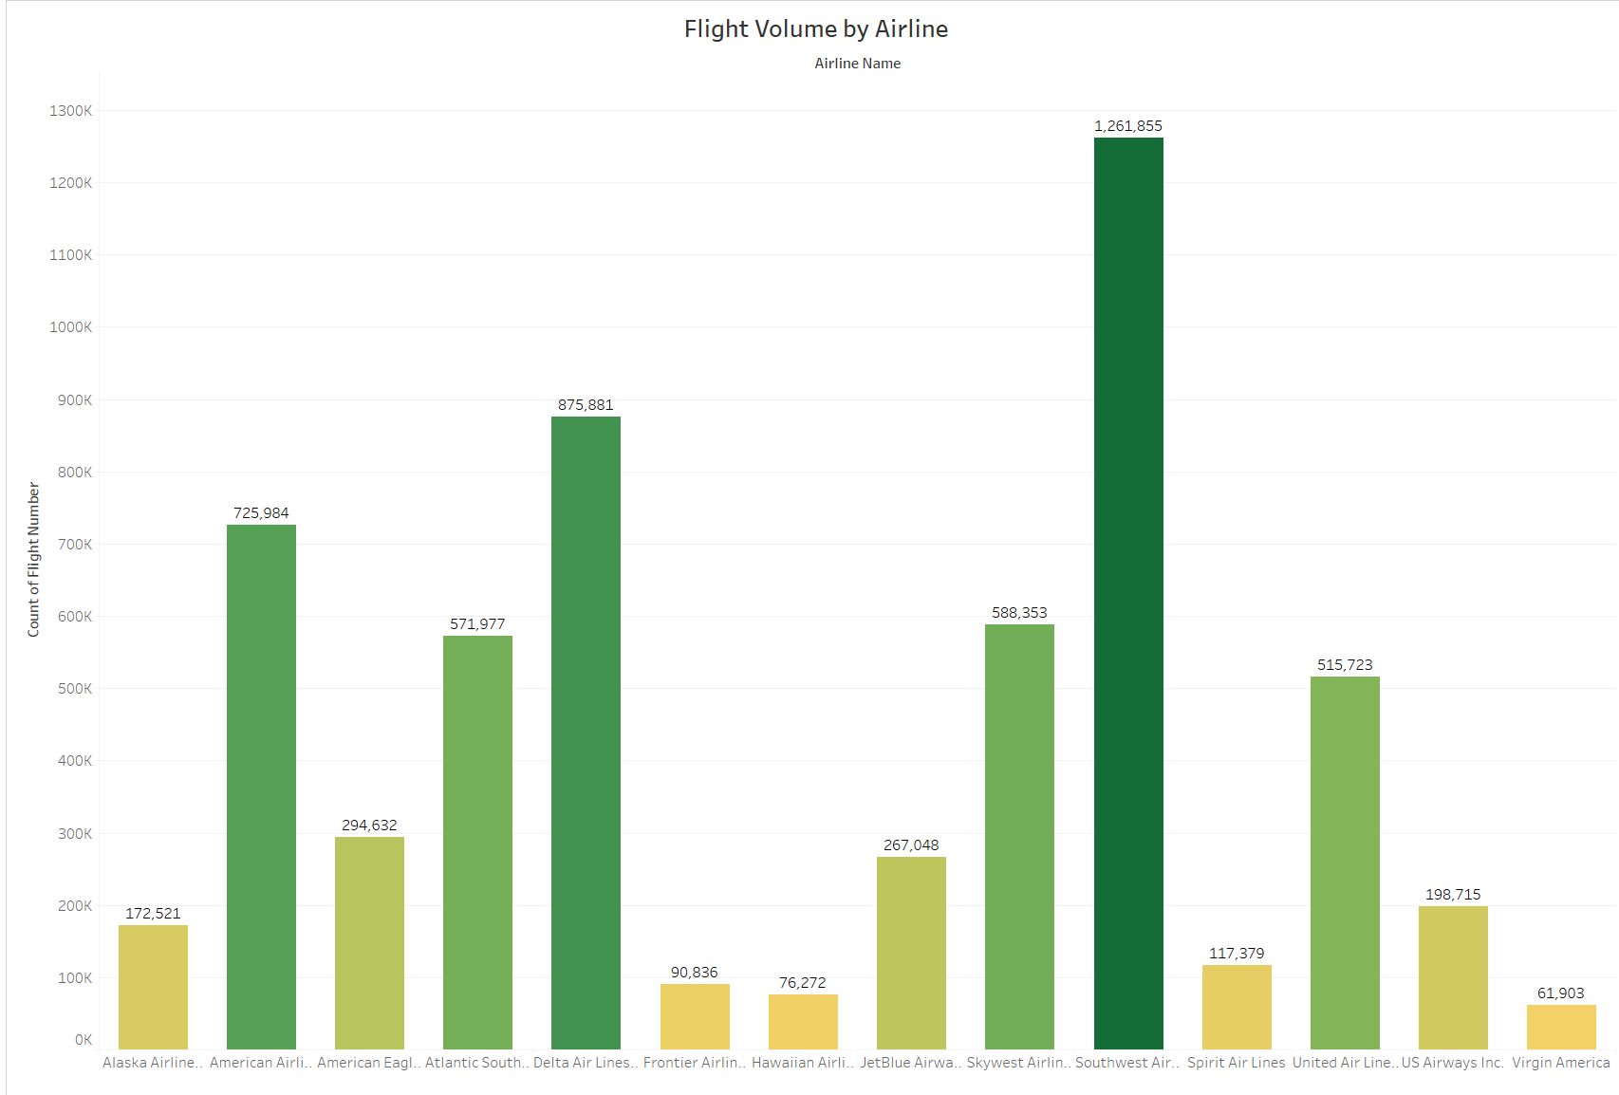
Chart 1- Flight Volume by Airline
Most flights are of Southwest Airlines Co. i.e. 1,621,855
Least frights are of Vergin America i.e. 61,903

Slide 7
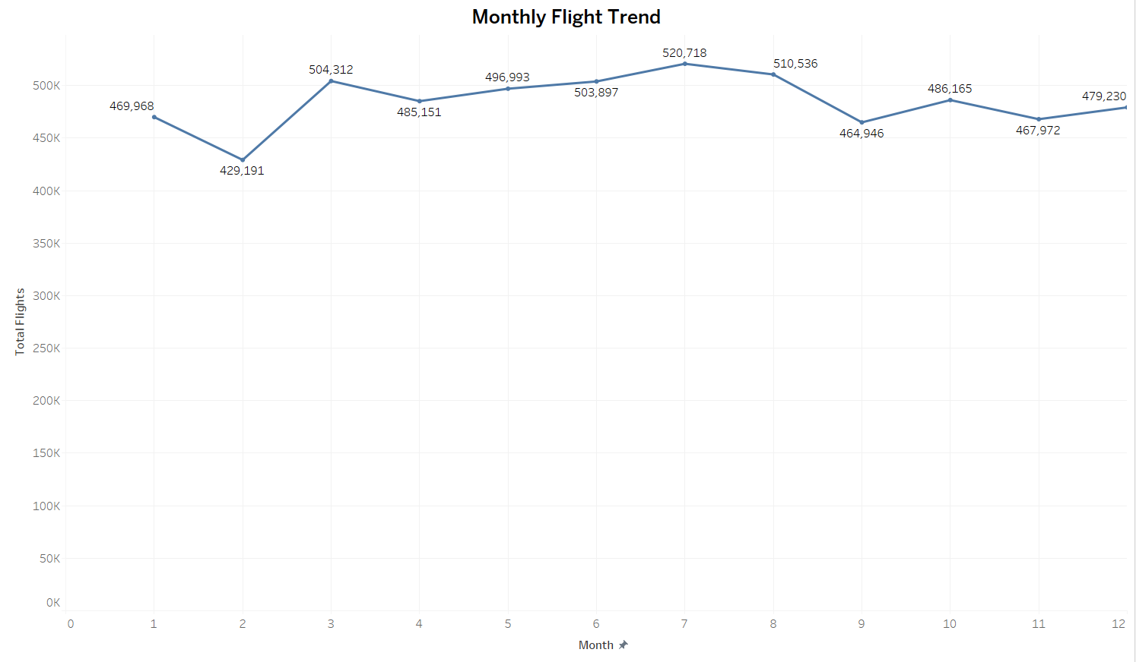
Chart 2- Monthly Flight Trend
The highest trend goes in the 7th month which is July with 520,718 number of flights.
And the lowest is in 2nd month which is February with 429,191.

Slide 8
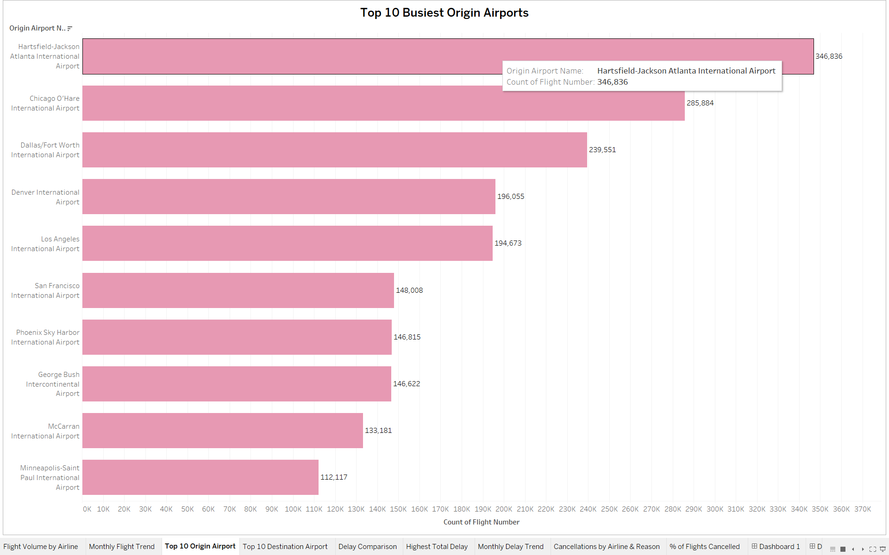
Chart 3- Top 10 Origin Airport
These are the Top 10 Airports of Origin with Hartsfield-Jackson Atlanta International Airport on top with 346,836 flights.
Followed by Chicago O'Hare International Airport with 285,884 flights and so on.

Slide 9
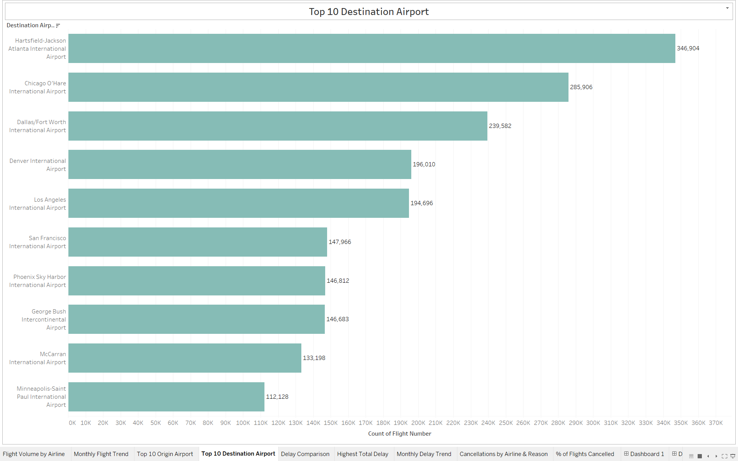
Chart 4- Top 10 Destination Airport
These are the Top 10 Airports of Destination with Hartsfield-Jackson Atlanta International Airport on top with 346,904 flights.
Followed by Chicago O'Hare International Airport with 285,906 flights and so on.

Slide 10
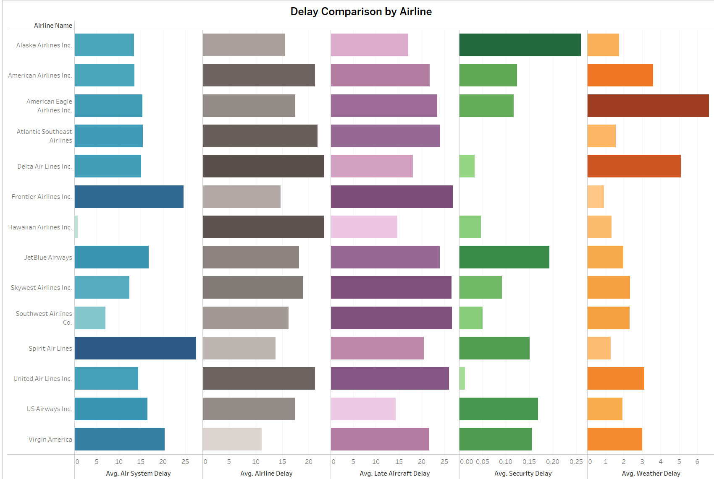
Chart 5- Delay Comparison by Airline
This chart shows delay comparison by airline.
The highest average delay due to Air System is in Spirit Airlines with average of 27.51 .
Due to Airline Delay it is in Delta Airlines with average of 22.94.
Due to Late Aircraft Delay it is Frontier Airline with 26.90.
In Security Delay it is Alaska Airlines with 0.26.
Due to Weather Delay it is American Eagle with 6.64

Slide 11
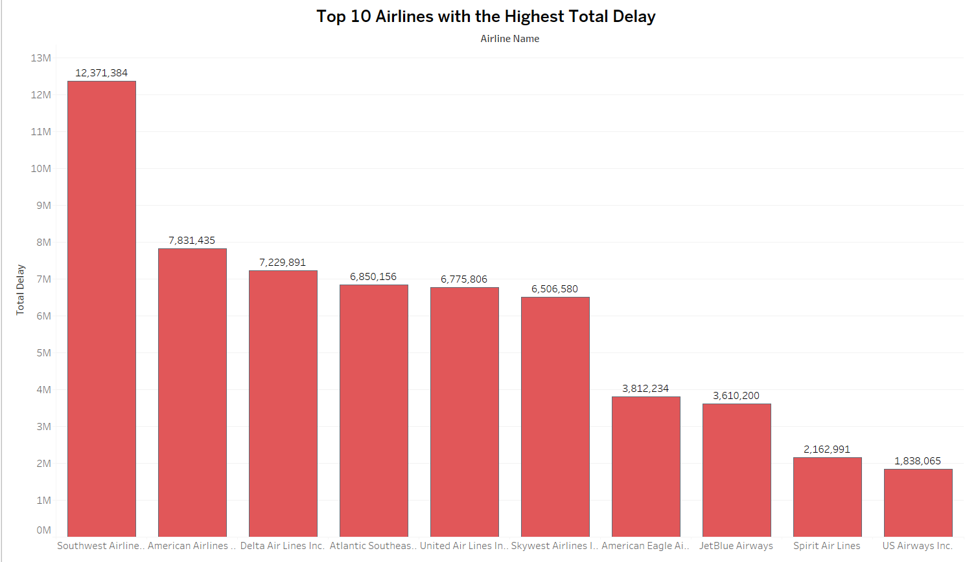
Chart 6- Top 10 Airlines with the Highest Total Delay
On top it is Southwest Airlines with total delay of 12,371,384 mins.
2nd we have American Airlines with total delay of 7,831,435 mins.
And on 10th position we have US Airways with total delay of 1,838,065 mins

Slide 12
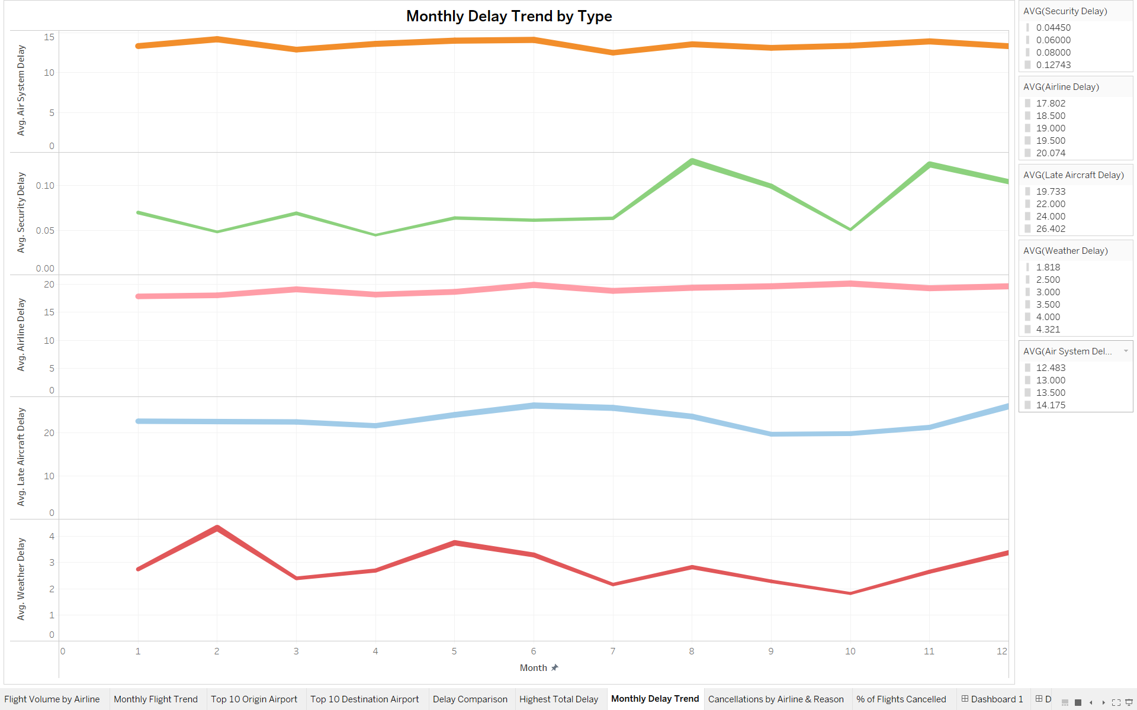
Chart 7- Monthly Delay Trend by Type
Here we can see monthly delay trend based on type (in average)

Slide 13
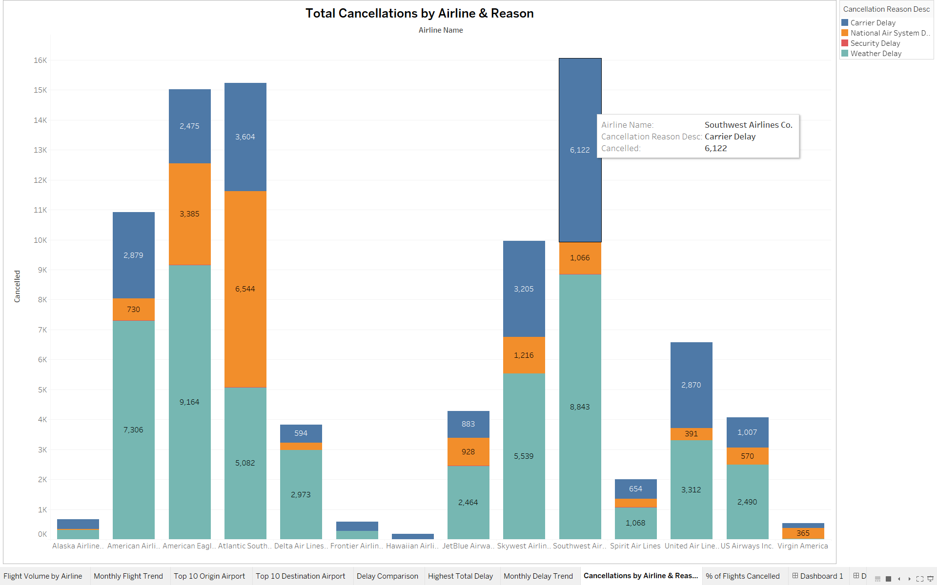
Chart 8- Total Cancellations by Airline & Reason
Southwest Airlines has the highest total cancellations among all airlines, with Weather Delay being the leading reason (8,843 cancellations), followed by Carrier-related issues.
American Eagle and Atlantic Southeast Airlines also show significantly high cancellations, mainly driven by National Air System Delays and Carrier Delays,

Slide 14
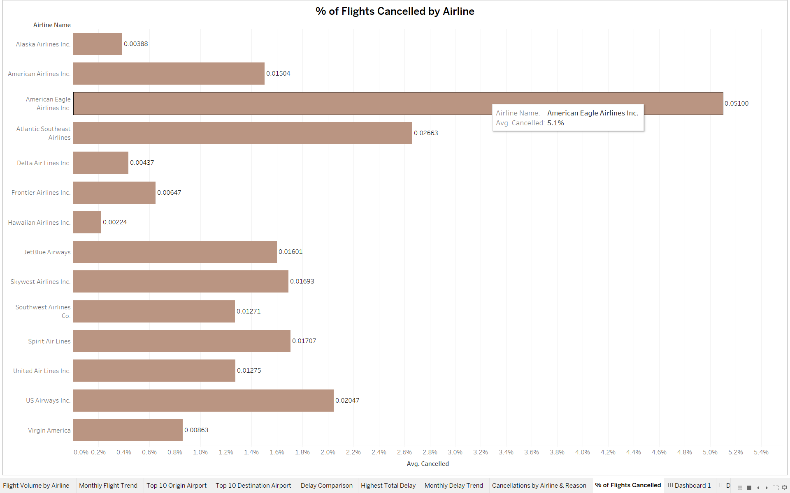
Chart 9- % of Flights Cancelled by Airline
American Eagle Airlines Inc. has the highest cancellation rate at 5.1%, indicating potential reliability concerns compared to other carriers.
Airlines like Hawaiian Airlines Inc. and Alaska Airlines Inc. show the lowest cancellation rates (below 0.5%), suggesting better operational consistency and performance.

Slide 15
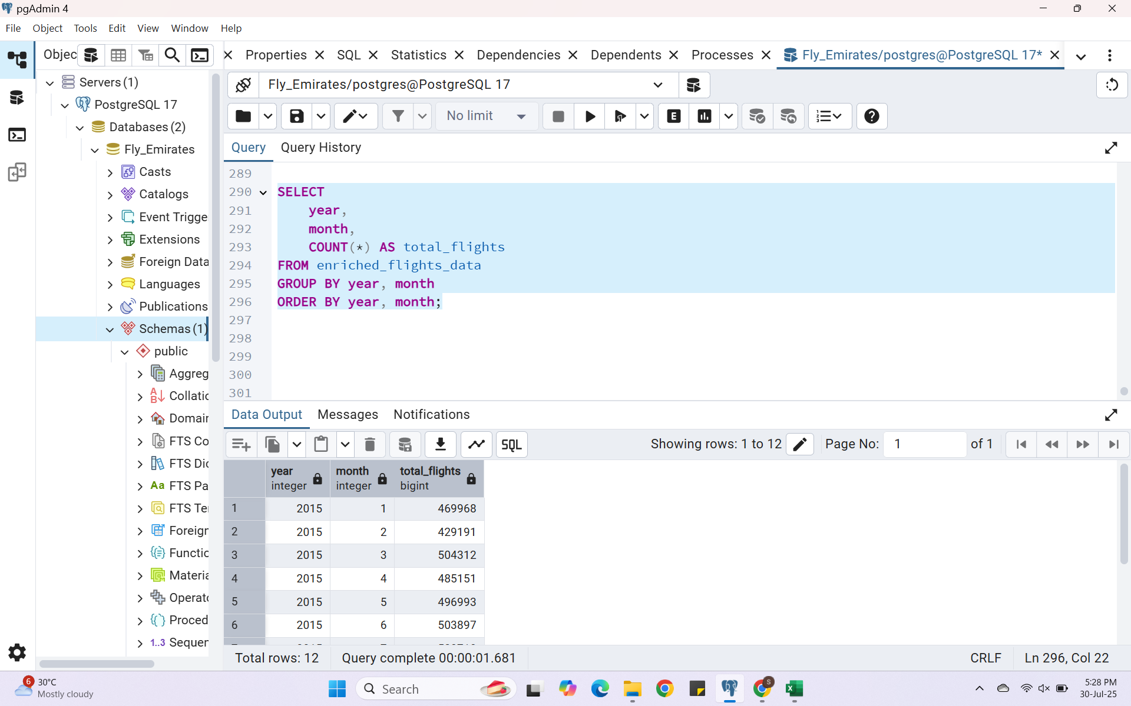
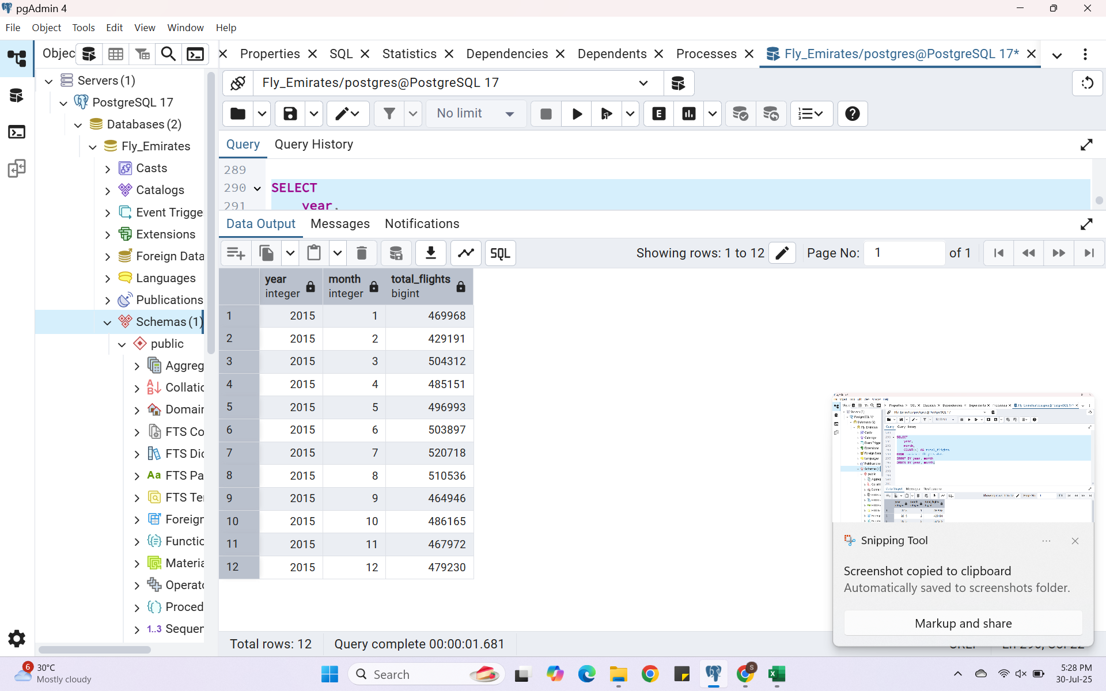
SQL Insights
Insight 1 Monthly Flight Volume
Peak month of travel is March with total flights 504,312
Low month travel is in February with total flights 429,191

Slide 16
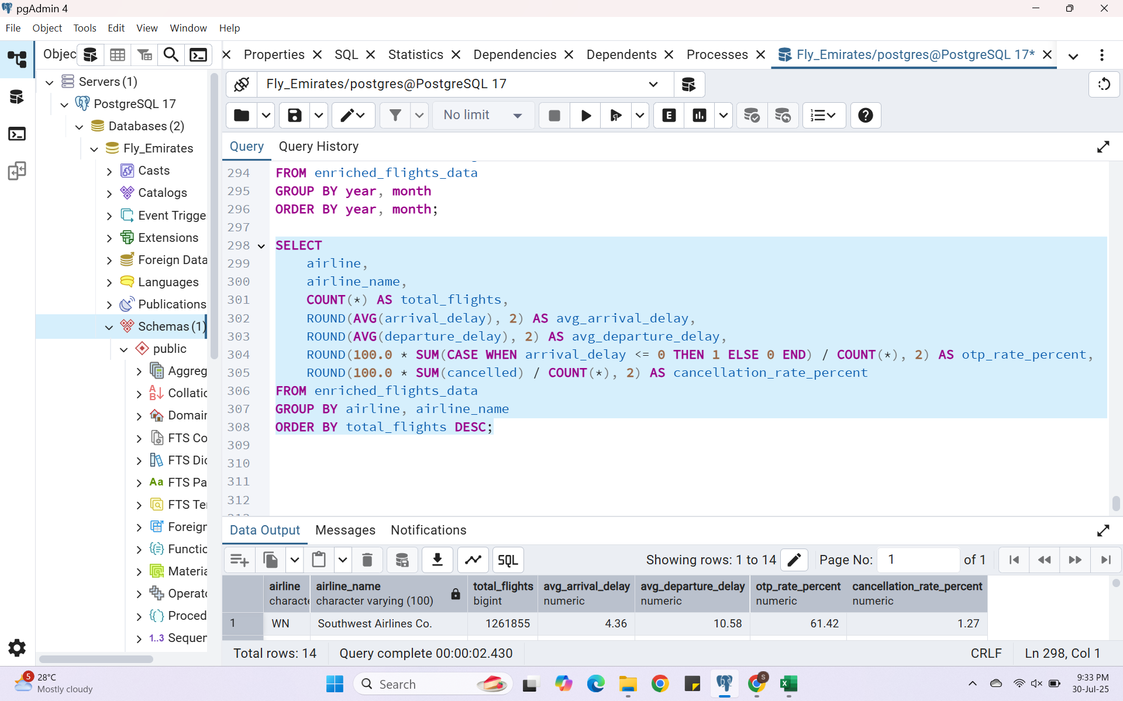
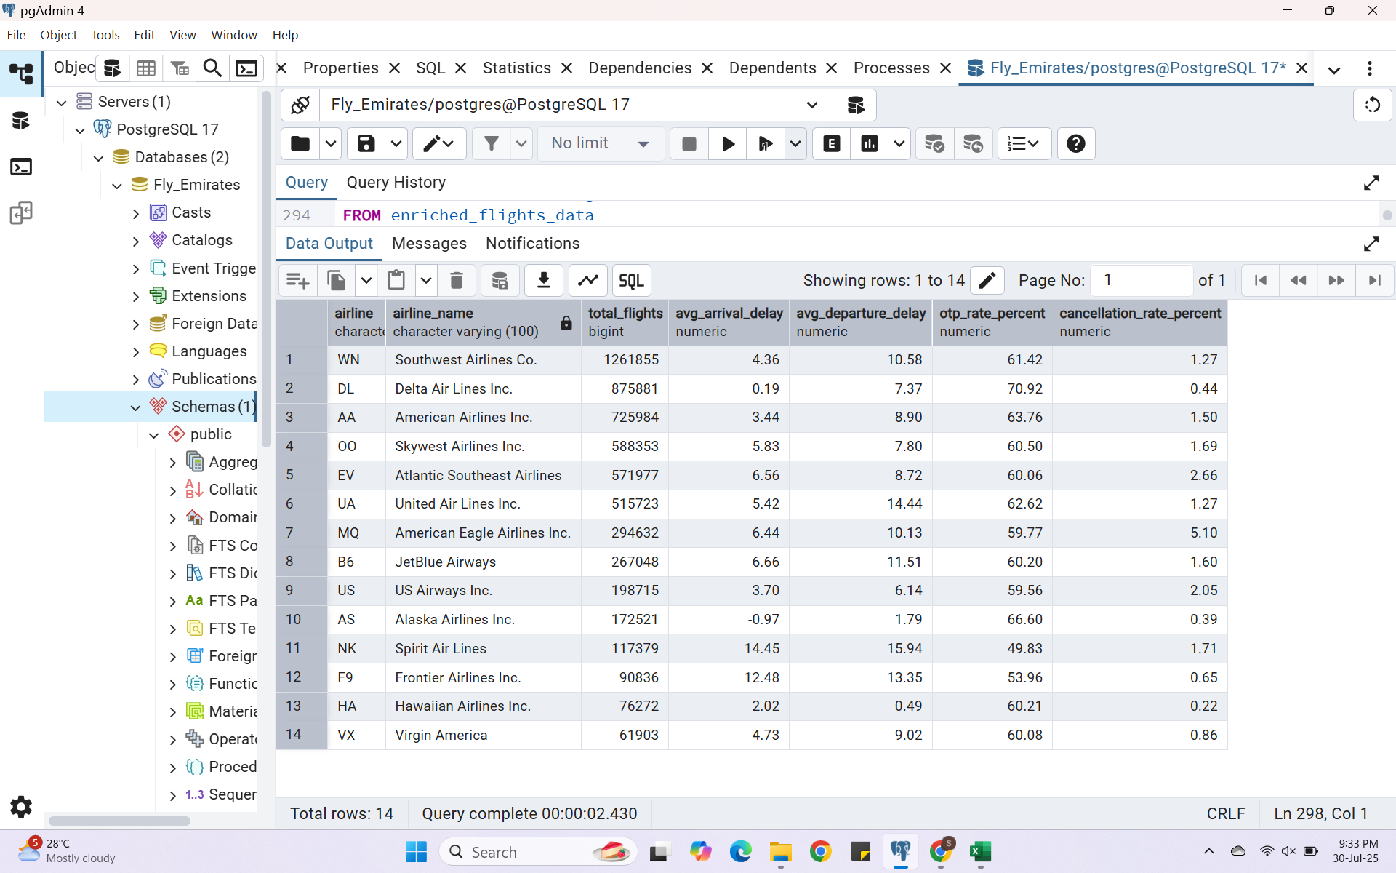
Insight 2 Airline Performance Summary
Highest number of flights are of Southwest Airlines Co.
Followed by Delat Airlines Inc.
And least is Virgin America

Slide 17
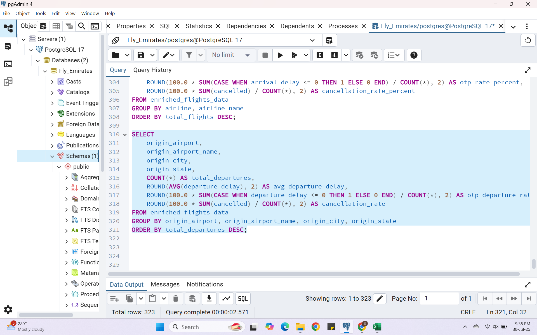
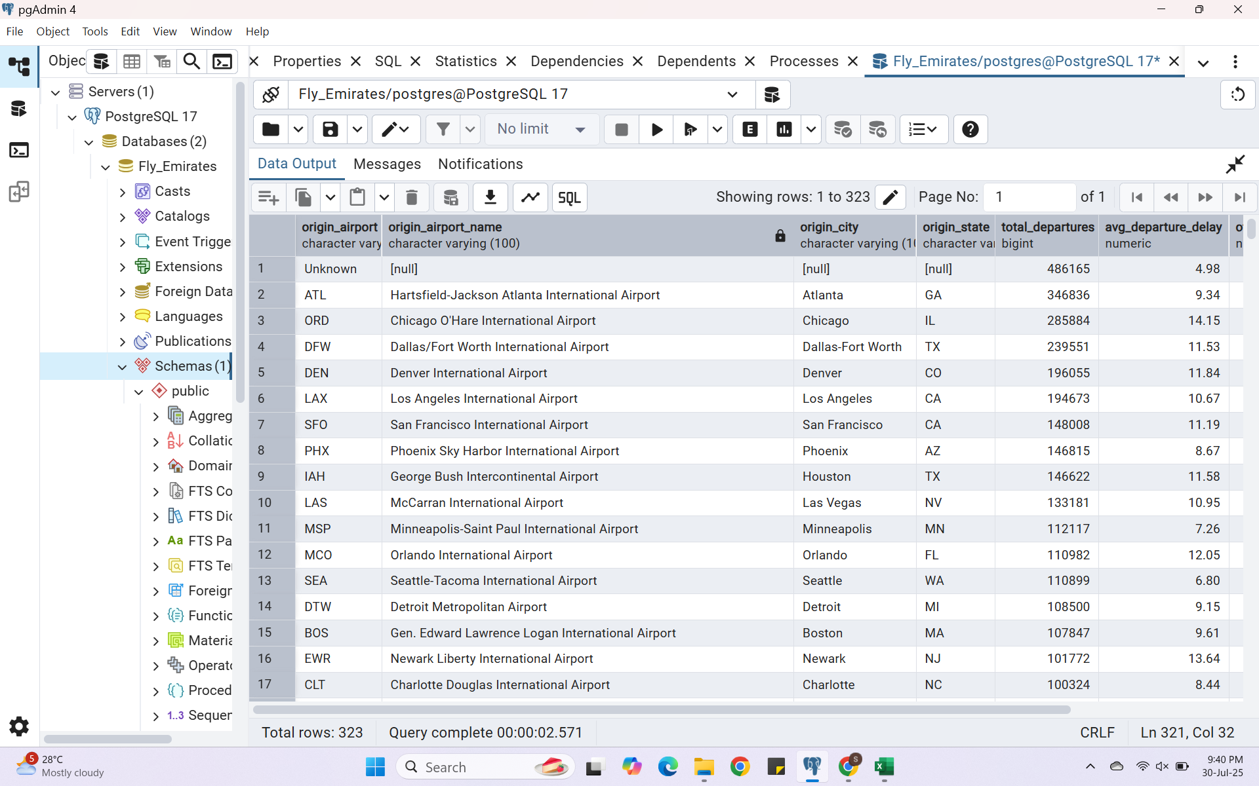
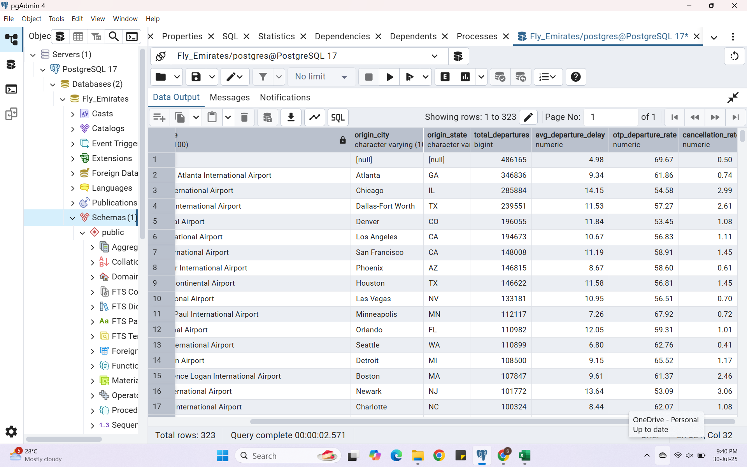
Insight 3 Airport Performance Analysis
First 17 rows

Slide 18
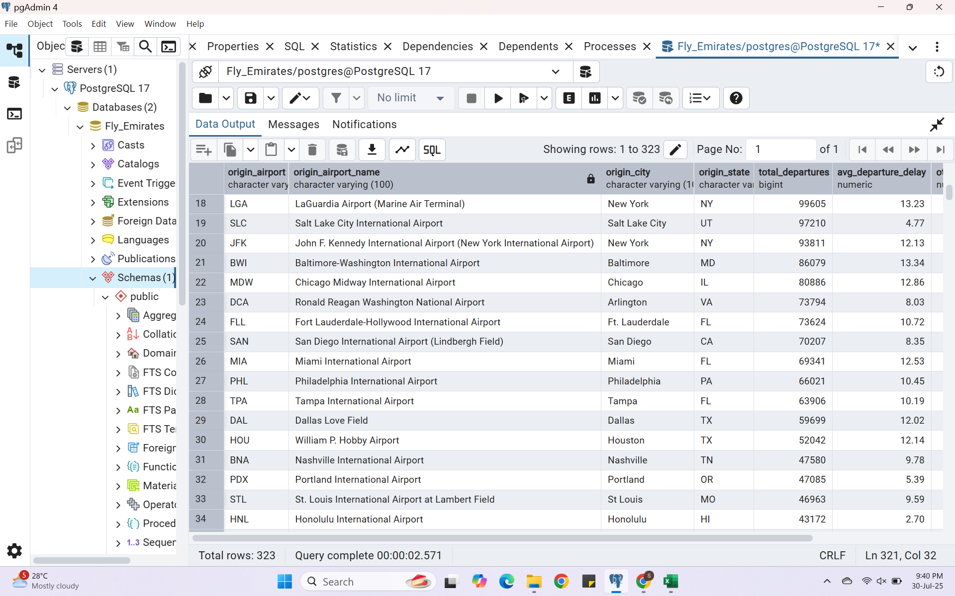
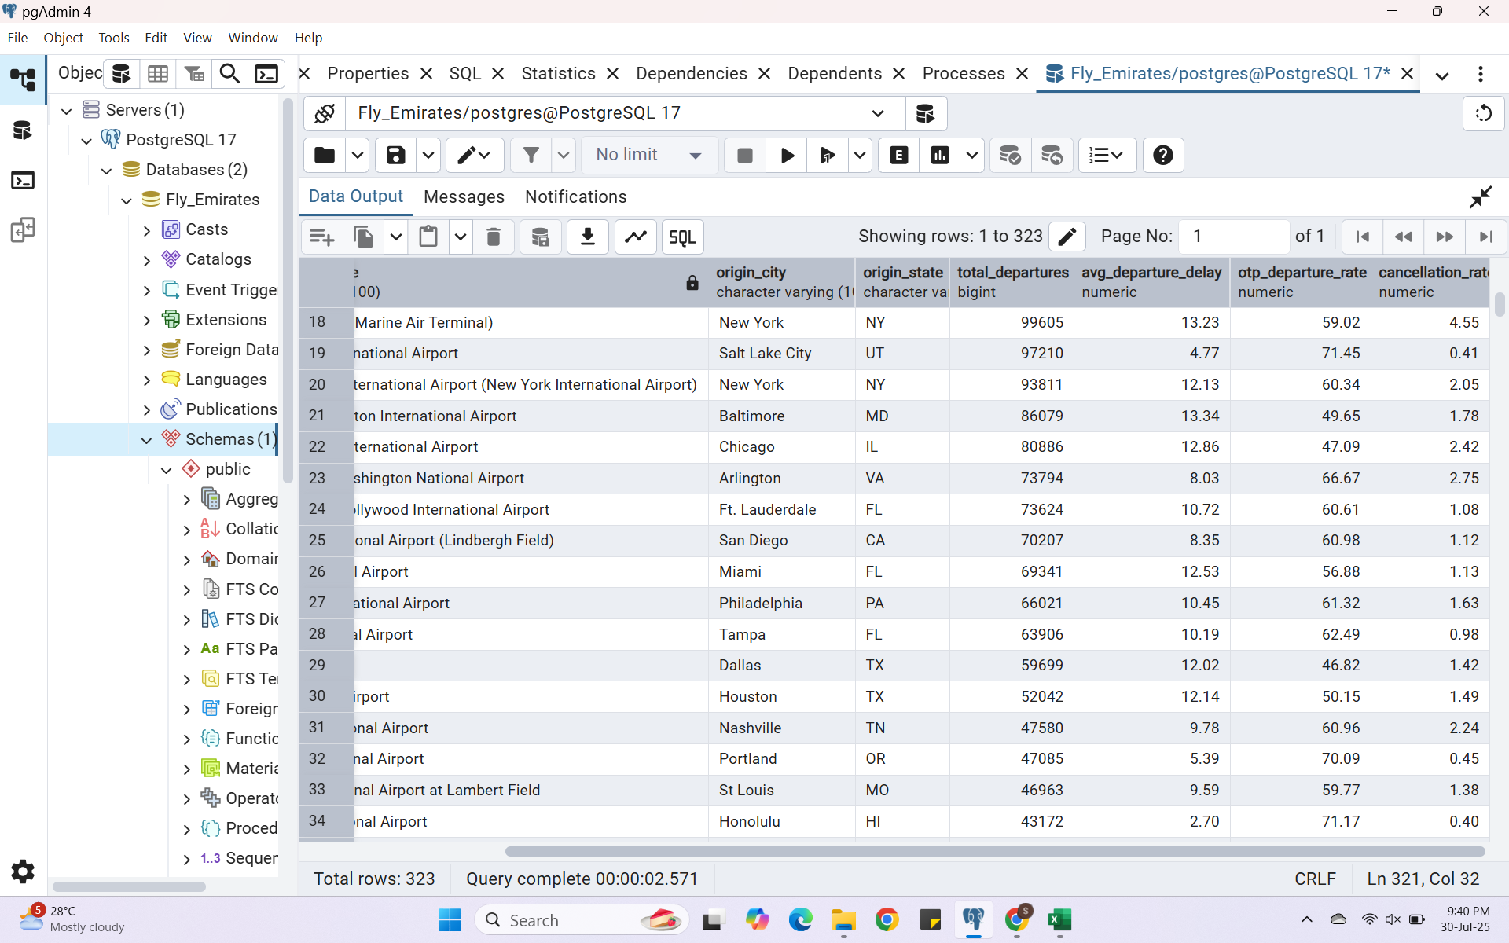
Most departure are from Hartsfield-Jakson Atlanta Airport (346,836)
Airport with best On Time Performance based on departure is Salt Lake City International Airport
18 – 34 rows

Slide 19
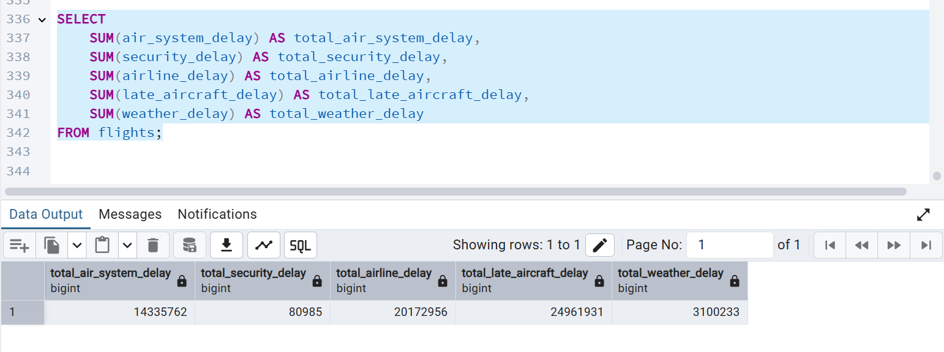
Insight 4 Total Sum of Each Delay Type
This query shows total minutes lost due each delay reason.
The most minutes lost were due to Aircraft Delay.
Least delay causing reason is Security Delay.

Slide 20
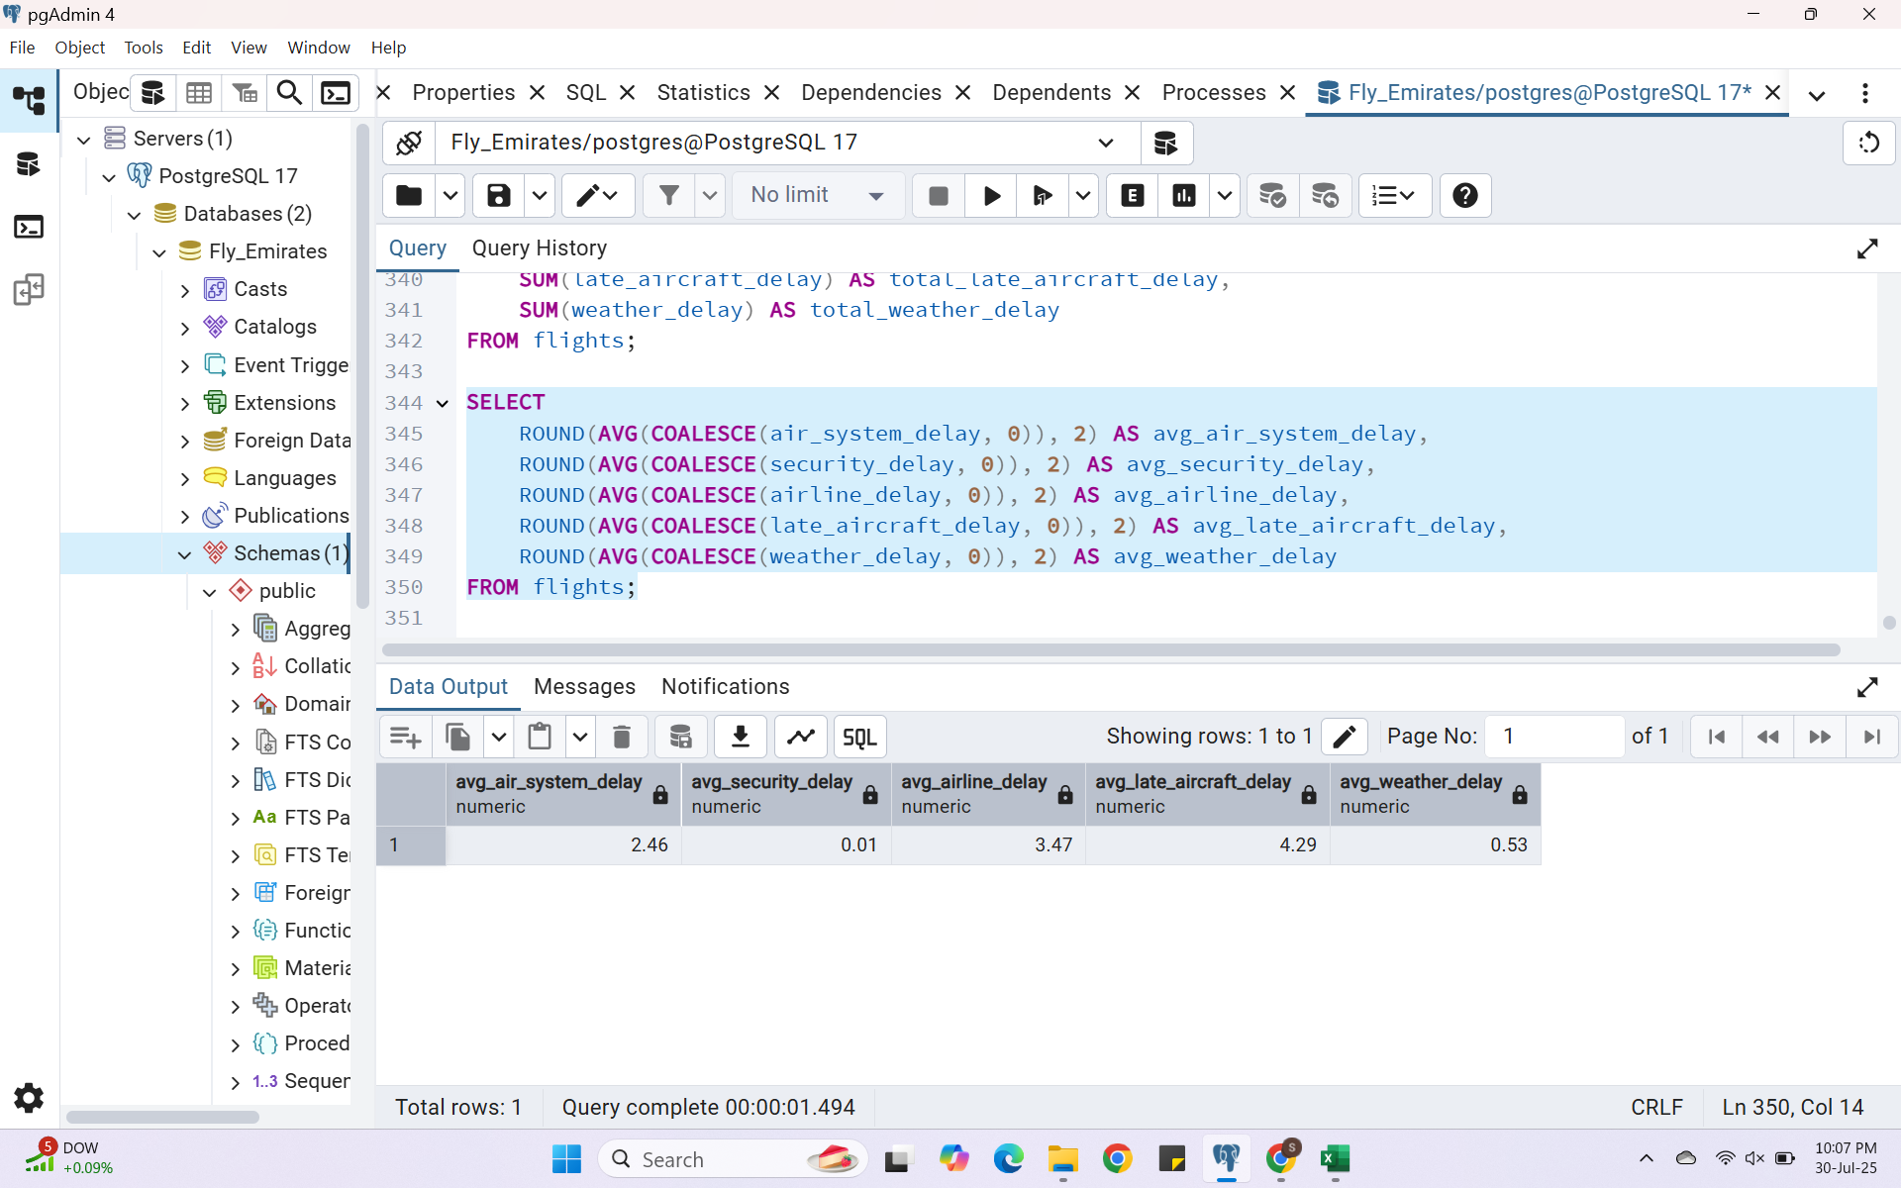
Insight 5 Average Delay per Flight for Each Reason
This helps us understand which delay is more frequent per flight.
Most frequent delay per flight is Aircraft Delay.
Least frequent delay per flight is Security Delay.

Slide 21
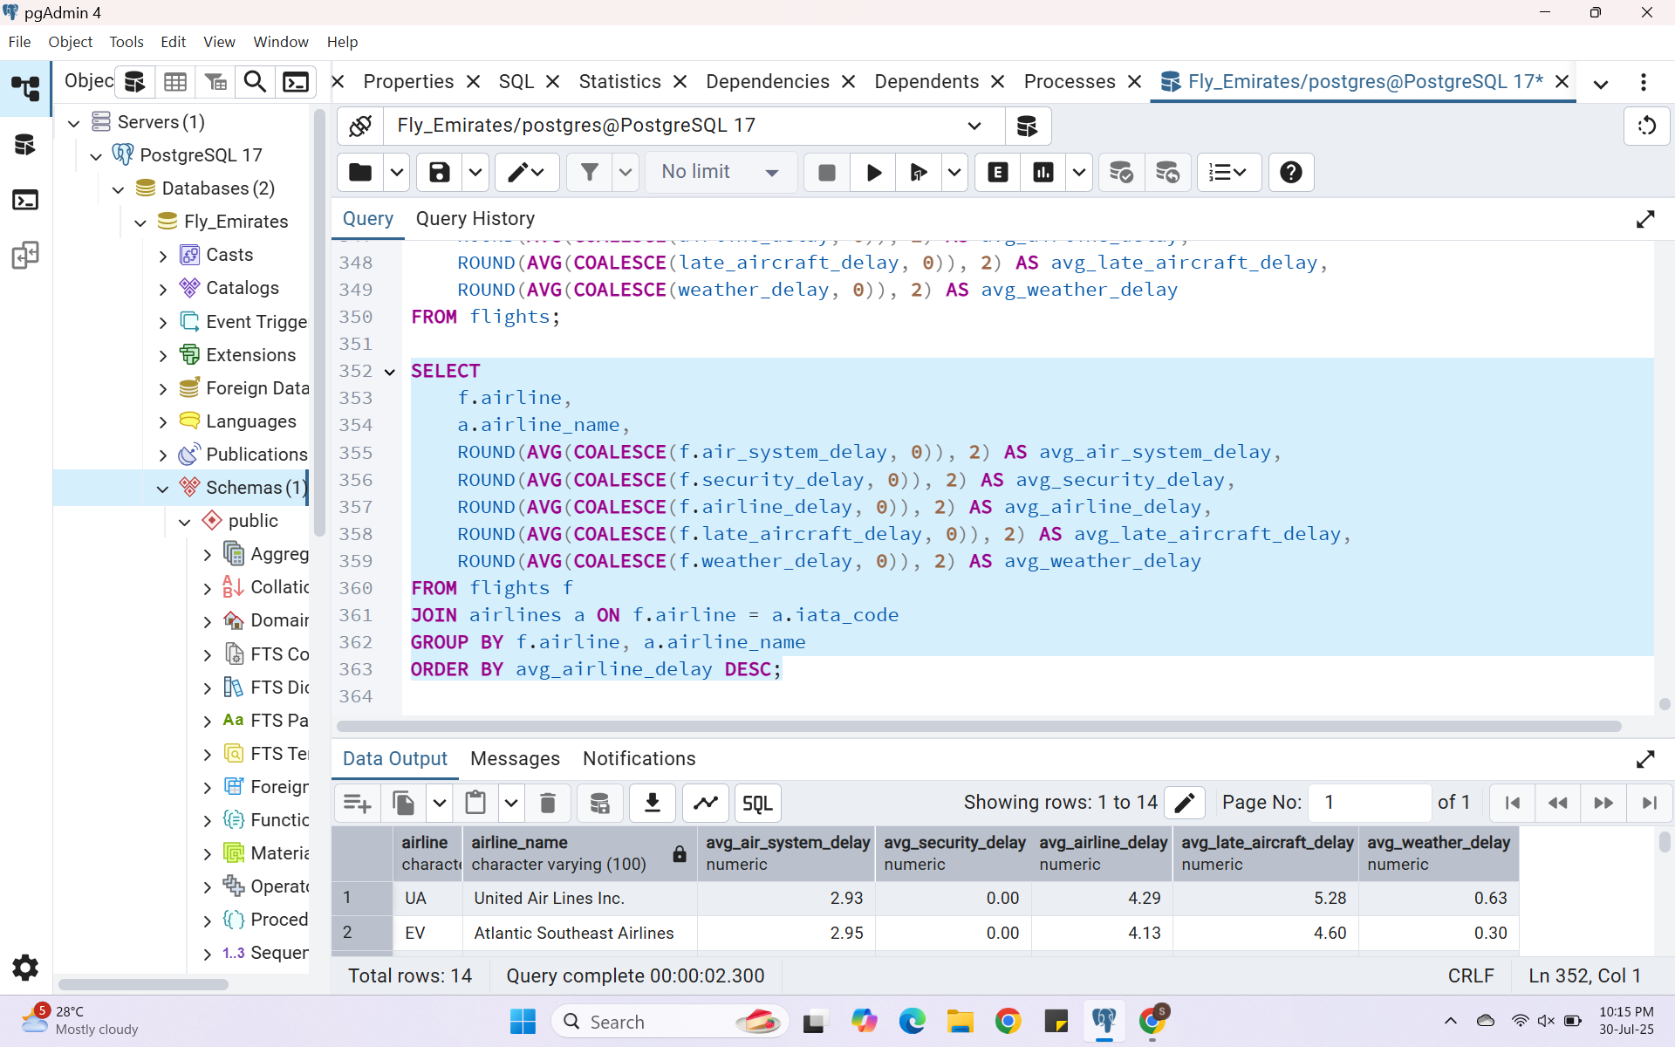
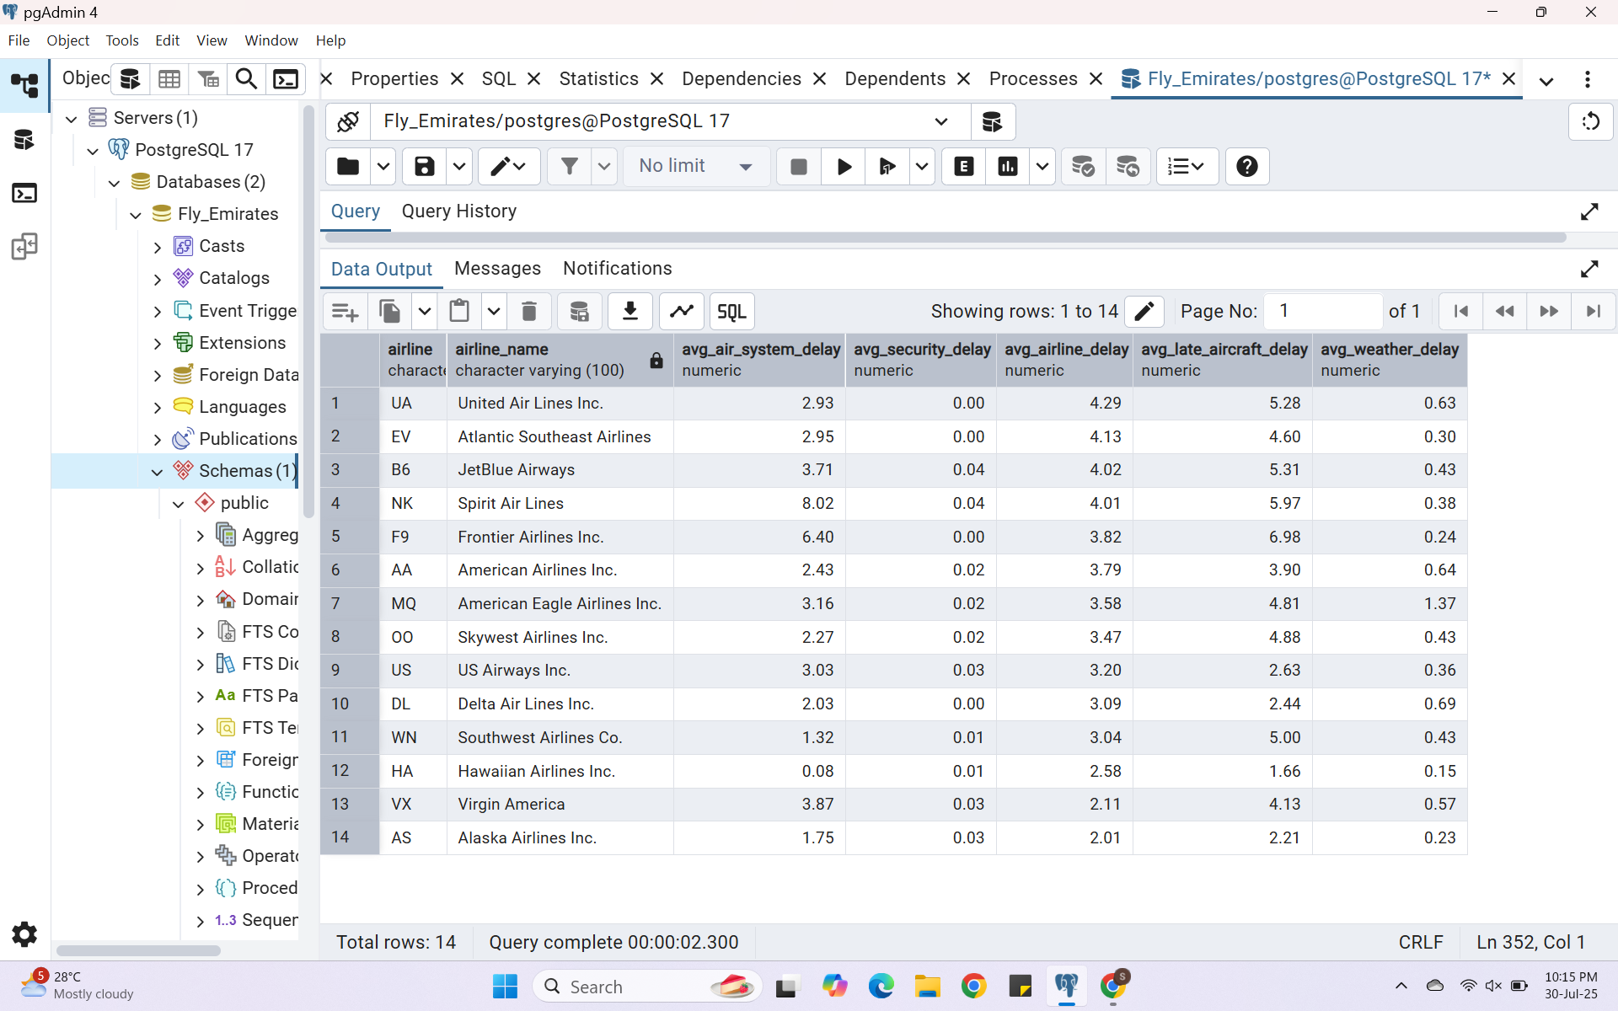
Insight 6 Delay Reasons by Airline
Due to Air System Delay the airlines which suffered the most is Spirit Airlines.
Due to Security Delay- JetBlue Airways and Spirit Airlines.
Due to Airline Delay- United Airlines.
Due to Aircraft Delay- Frontier Airlines.
Due to Weather Delay- Delta Airlines

Slide 22
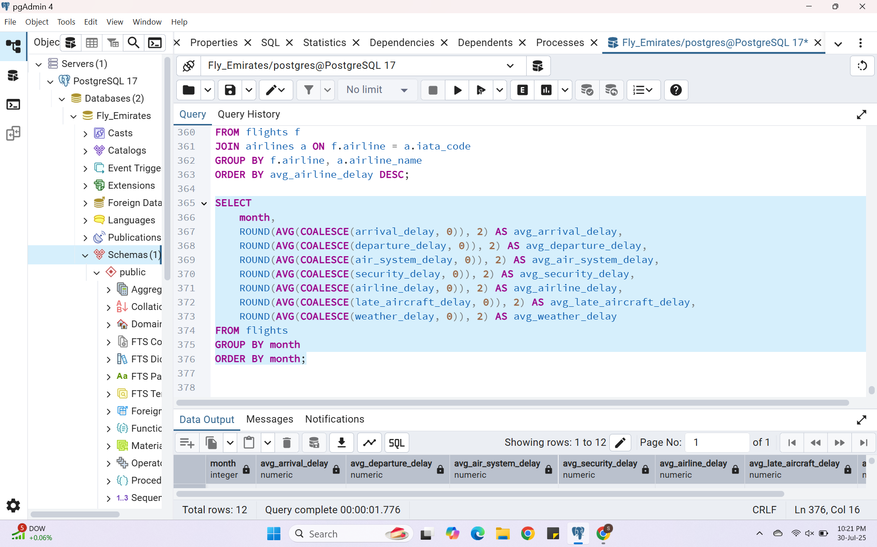
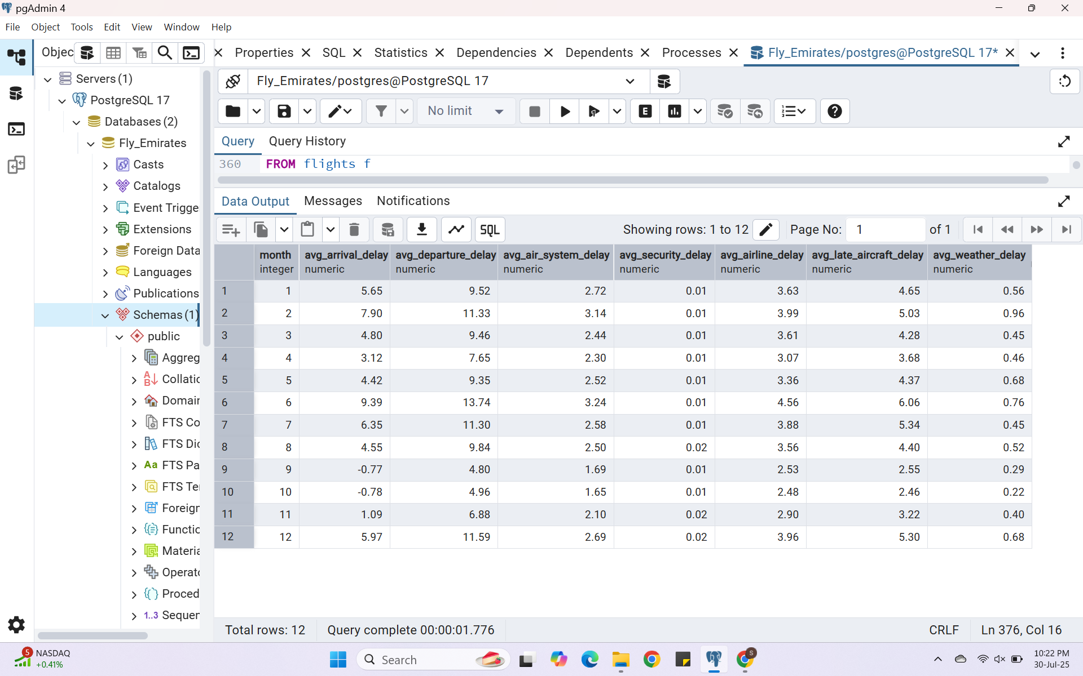
Insight 7 Delay by Month
According to this we can see that June has highest delay in almost all delay types and September, October has least delay.
We can say that most people prefer not to travel in summers.

Slide 23
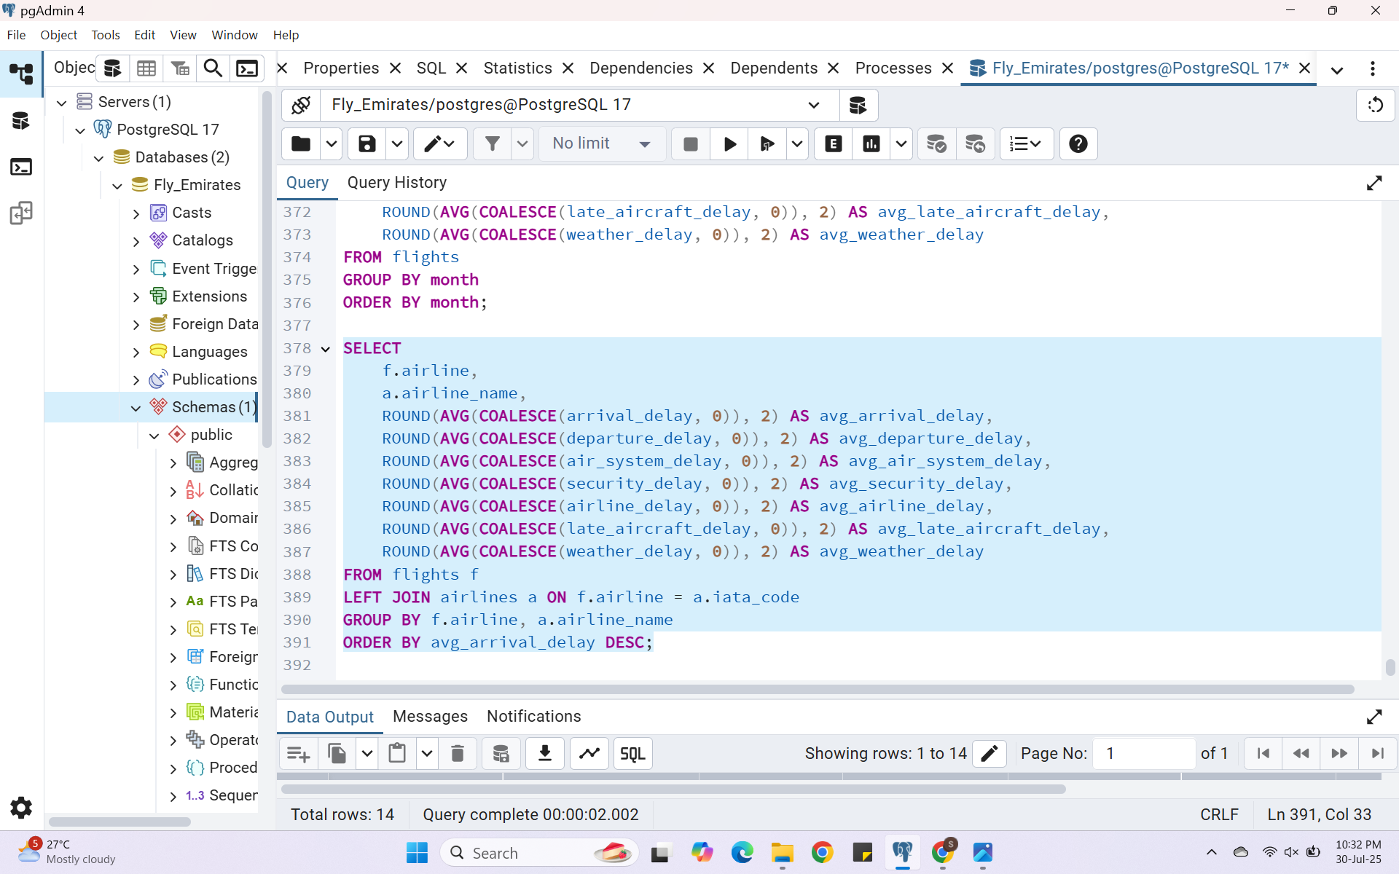
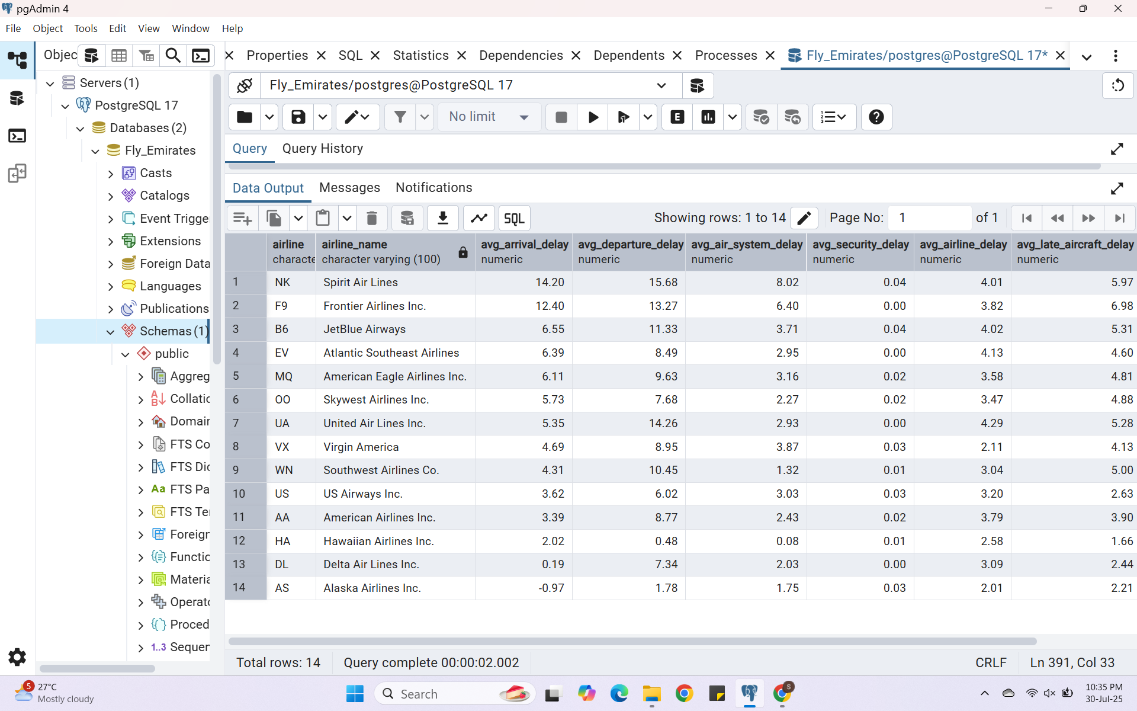
Insight 8 Delay Analysis by Airline
By looking at this we can say that Spirit and Frontier Airline has the most delays.
Hawaiian Airlines and Alaska Airlines are best performing airlines in terms of delays

Slide 24
Thank you
Himanshu
Domain- Data Analyst
hiimanshuu0406@gmail.com

